Slide 1



ecx.io Frontend Bootcamp — Introduction to HTML: Part 1 15.06.2021.

Slide 2



Introduction round

Slide 3

Mario Peroković
Ecx.io position
Senior Frontend Developer
Domain Owner, SAP CX Frontend
Experience
Frontend experience: ~8y
Ecx.io experience: ~5y
Clients in ecx.io
Doka, Mondi, Lenzing, Wienerberger, Siemens

Slide 4
Introduction round

Slide 5
What will we do in this course?

Slide 6

What will we do in this course?
Introduction to HTML
HTML Semantics
Multimedia
Interactivity and HTML forms
Accessibility

Slide 7
Before we start

Slide 8
Visual Studio Code
https://code.visualstudio.com/
Install the editor
Extensions
Live Server
Auto Rename Tag

Slide 9
Introduction to HTML: Part 1

Slide 10
Agenda
History
Overall Structure
[lunch break]
Head / Metadata
Structure and syntax
Exercises

Slide 11
What is HTML?

Slide 12
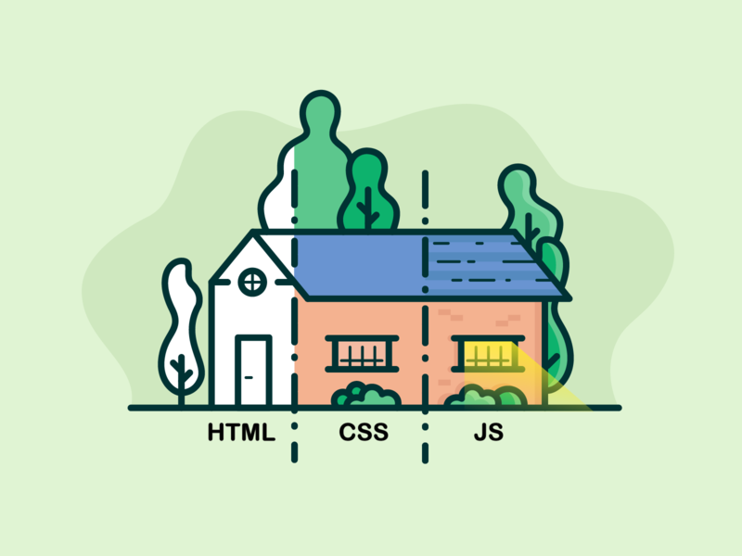
About HTML
HyperText Markup Language
Most basic building block of the web.
Defines the meaning and structure of web content.
Markup language, tells browsers how to structure web pages.

Slide 13
About HTML
Consists of series of elements which wrap or mark up different parts of content, to make it appear or act in a certain way.
HTML element recognized by tags, which contains the element‘s name, surrounded by < and >.
Element name is case in-sensitive.

Slide 14
History
Initial version specified by Tim Berners-Lee in 1991 with 18 elements
11 of those are still present in HTML 5
Version | Year
HTML | 1991
HTML 2 | 1995
HTML 3 | 1997
HTML 4 | 1997
HTML 5 | 2014

Slide 15
History
In HTML 5, new elements were added to enrich the semantic content of web pages.
With them, we provide not only the content, but also we can precisely describe what the content actually is.

Slide 16
Overall Structure

Slide 17
Overall Structure

Slide 18
DOCTYPE
Set of rules that HTML page has to follow to be considered as „good“ HTML
Recently, „doctype“ is just a historycal artifact

Slide 19
Overall Structure
<html>
- the root html element, wraps all the content
<head>
- wrapper for everything that has to be included on the page, but is not content
<body>
- wrapper for all the content of the page

Slide 20
Entity references
In order to render special characters (that are part of HTML syntax), we have to use entity references.
Complete list of references
Character | Char. reference
< | &lt;
> | &gt;
“ | &quot;
‘ | &apos;
& | &amp;

Slide 21
HTML Comments
There is a way to comment out parts of HTML which browsers will ignore while rendering the page
<!-- … -->

Slide 22
Exercises
Create an HTML file with initial structure.
Create an HTML file and add an equation for calculating the circle extent.
Create an HTML file and add an equation for the Pythagorean theorem.
Create an HTML file and add some content to it. Prevent part of the content to be shown to the user by commenting it out.

Slide 23
Head / Metadata

Slide 24
What’s inside the head
Part of HTML which is not displayed in the browser when page loads
Contains info such as page title, description, links to CSS files, metadata, etc

Slide 25
Title
Used to add a title to the document
Can get confused with the “<h1>“ from the body (which is used to add a top level heading)
<h1> - appears on the page when loaded in browser, used only once to mark up the title of the page content (e.g. story title, product name, etc..)
<title> - metadata that represents the title of the entire HTML document

Slide 26
Metadata
Data that describes data.
Most of the <meta> elements have “name“ and „content“ attributes.
Character encoding
Specifies the character encoding of the document - the set of chars that document is allowed to use.
„utf-8“ is a universal char set which includes almost all characters from most of the languages.
Eg. „ISO-8859-1“ cannot display Japanese characters.

Slide 27
Metadata – author and description
Author
Beneficial info of the document, as we know who wrote the page
Content management systems do this automatically
Description
Should include keywords
Improves scoring result in search engines

Slide 28
Metadata – Open Graph
Metadata protocol invented by Facebook.
Provides richer metadata for websites.

Slide 29
Metadata – Twitter Cards
Metadata protocol invented by Twitter.
Provides richer metadata for websites.

Slide 30
Exercises
Create an HTML file with a charset value of “ISO-8859-1” and add following Japanese content to it: <p>Japanese example: ご飯が熱い。</p>
Modify the charset to “utf-8” and validate that the content is displayed correctly.
Create author, open graph and twitter cards metadata for an imaginary newspaper article.

Slide 31
Favicon and custom icons
Favicon - small squared icon visible in browser‘s tab or in bookmark.
Most of the browsers support „.gif“ or „.png“ formats, but the standard is „.ico“ (supported in IE6 ☺)
Nowadays, for the support of PWA, different icons can be provided:
shortcut icon
icon
apple-touch-icon
apple-touch-icon-precomposed

Slide 32
Exercises
Generate favicon using an online tool https://favicon.io
Example: https://favicon.io/emoji-favicons/soon-arrow/
Create an HTML file and use the generated icon

Slide 33
Applying CSS and JS to HTML

Slide 34
Applying CSS and JS to HTML
CSS
Used to make the websites look cool
Included with „<link>“ element
Should always go inside the head
JavaScript
Used to give the website some behaviour
Included with “<script>“ element
Should go inside the head, but can be part of body as well
Needs a closing tag, as the script can be provided inside instead in separate file

Slide 35
Exercises
Create an HTML file and load an external JavaScript and CSS file. Find the content for both of the files below, or create it at your will: - script.js console.log('Hello from JS file'); - styles.css body { background-color: lightsalmon; }

Slide 36
Language of document
Document should always has the language set
Brings additonal value, search engines will index the page more effectively
Has an impact on the screen readers
Additionally to the entire document, language can be set in a separate subsections.

Slide 37
Structure and syntax

Slide 38
HTML elements
An element is part of a webpage. It can contain a data item, or a chunk of text or image.
Opening tag
Name of the element, wrapped in opening and closing brackets.
Content
Content of the element.
Closing tag
Same as opening, with a „slash“ before the element name.

Slide 39
HTML elements
Nested elements
Elements can be placed within other elements.
Self-closing elements
They are also called empty or void elements.
Consist of a single tag
Closing slash is optional, but can increase readability.

Slide 40
HTML elements
Whitespace
Any string of text composed only spaces, tabs or line breaks.
It‘s presence can cause layout problems.
They are usually ignored in display, but do not dissapear. There will still be text nodes containing only whitespace.

Slide 41
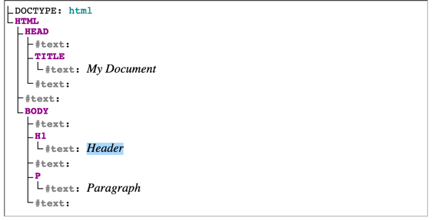
Source: https://developer.mozilla.org/en-US/docs/Web/API/Document_Object_Model/Whitespace/dom-string.png

Slide 42
Exercises
1. Create an HTML file with several elements inside. Additionally, provide nested and self-closing elements too.

Slide 43
HTML attributes
HTML elements can have attributes.
Attribute extends an element, changing it‘s behaviour or providing metadata.

Slide 44
HTML attributes
Attribute should have:
Space between attribute and element name (in case more attributes are present, they have to be separated by spaces too).
Attribute name, followed by an equal sign.
Attribute value, wrapped in quote marks.

Slide 45
HTML attributes
Boolean attributes
Attributes without the equals sign or a value.
It‘s a shorthand for providing the empty string, or a boolean value in HTML.

Slide 46
HTML attributes
Boolean attributes
HTML5 defines restrictions on boolean attributes
If attribute present, it has to have a case-insensitive value
„true“ and „false“ values are not allowed
To represent a false value, the attribute has to be omitted

Slide 47
Exercises
1. Create an HTML file and add two elements to it: - anchor element - button element - which should be disabled.

Slide 48
HTML validator

Slide 49
HTML validator
https://validator.w3.org/
„Validate by Direct Input“

Slide 50
References
https://developer.mozilla.org/en-US/docs/Learn/HTML/Introduction_to_HTML
https://favicon.io
https://validator.w3.org

Slide 51
Friday exercise
With everything we've covered so far, create an HTML page which should represent one blog post. - Focus on creating a correct HTML structure - Add the needed metadata - author, description - open graph and twitter cards - set the correct language of document - Add the favicon - Link simple CSS and JavaScript files (add the content to both of them on your own) - Blog post - should consist of title, several paragraphs, some images and external link - additionally, it should contain one disabled checkbox element - Note: Do not worry about using correct elements for certain parts of the page

